Slide 1





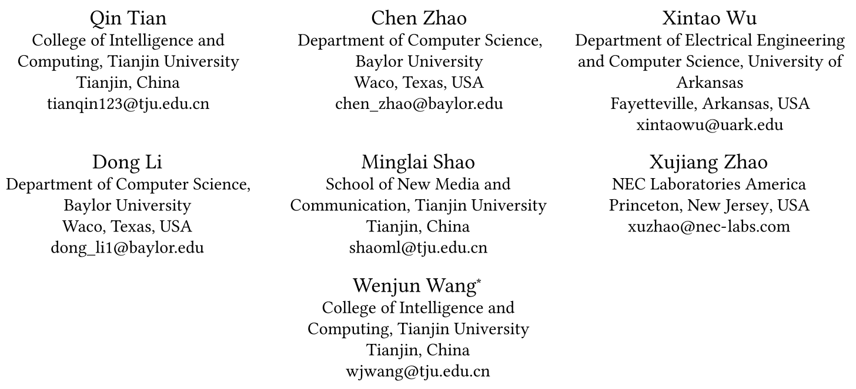



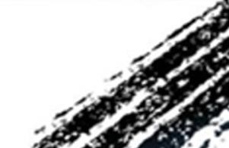

ATAI
Advanced Techniqueof Artificial Intelligence
ATAI
ChongqingUniversity _{AdvancedTechniqueof}
of Technology Artificial Intelligence
Chongqing University of
Technology
Chongqing University ^{ATAI}
_{of Technology} Advanced Techniqueof
Artificial Intelligence
Chongqing University of Technology
Chongqing University of Technology
Class Domain Incremental Learning on Graphs via Disentangled Knowledge Distillation
Code: None
—— WWW_2026
Reported by HongLiang Nie
1

Slide 2

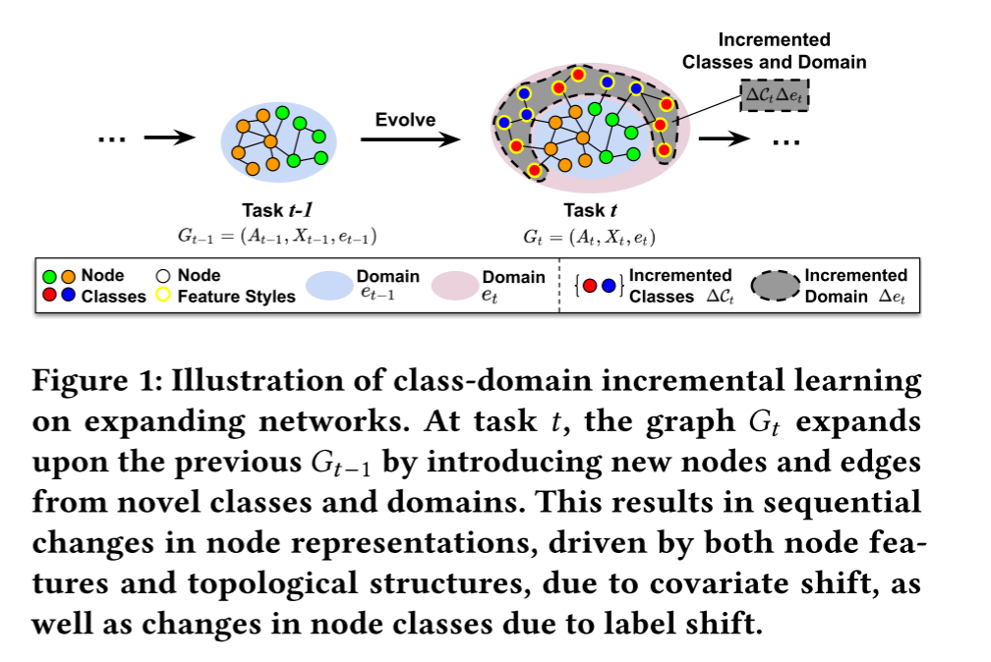
ATAI
AdvancedTechniqueof
Artificial Intelligence
ATAI
ChongqingUniversity _{AdvancedTechniqueof}
of Technology Artificial Intelligence
ChongqingUniversity of Technology
Motivation
(1) The newly introduced nodes, with new classes，distinct node feature styles, and additional edges, result in the new graph exhibiting covariate and label distribution shifts compared to previous graphs，Another key challenge is ensuring that the classifier learned on the new graph maintains its ability to generalize across all previous graphs while preserving prediction accuracy for node classification, effectively mitigating catastrophic forgetting.

Slide 3

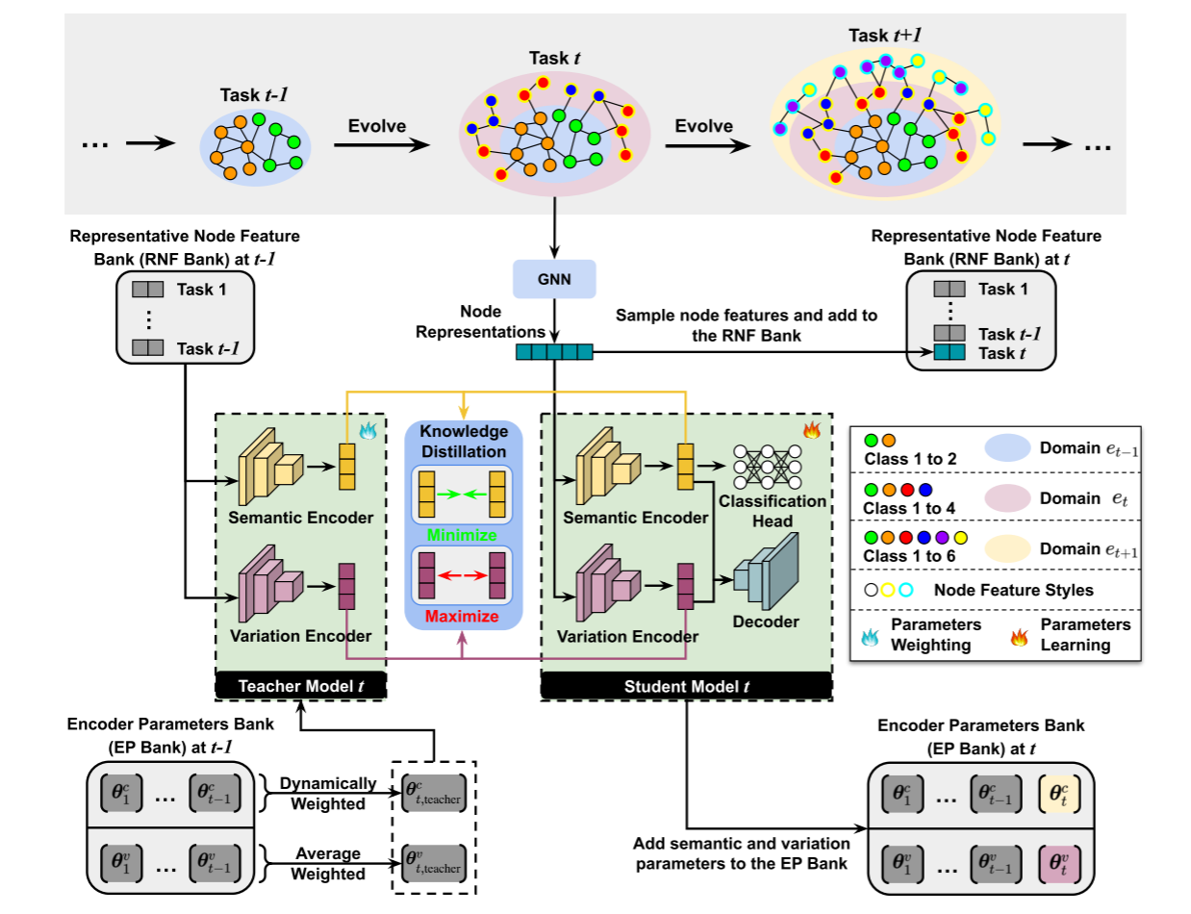
ChongqingUniversity of Technology
ATAI
AdvancedTechniqueof
Artificial Intelligence
ATAI
ChongqingUniversity _{AdvancedTechniqueof}
of Technology Artificial Intelligence
Overview

Slide 4









ChongqingUniversity of Technology
ATAI
AdvancedTechniqueof
Artificial Intelligence
ATAI
ChongqingUniversity _{AdvancedTechniqueof}
of Technology Artificial Intelligence
Method

Slide 5

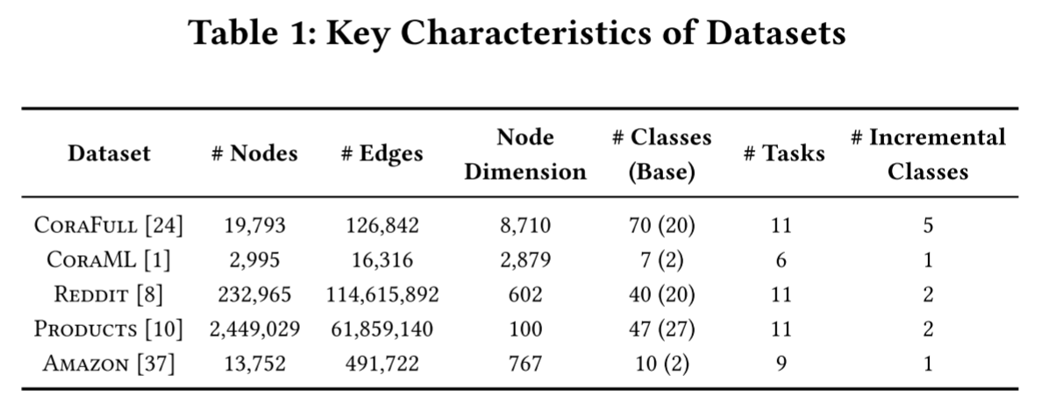
ATAI
AdvancedTechniqueof
Artificial Intelligence
ATAI
ChongqingUniversity _{AdvancedTechniqueof}
of Technology Artificial Intelligence
ChongqingUniversity of Technology
Experiments

Slide 6
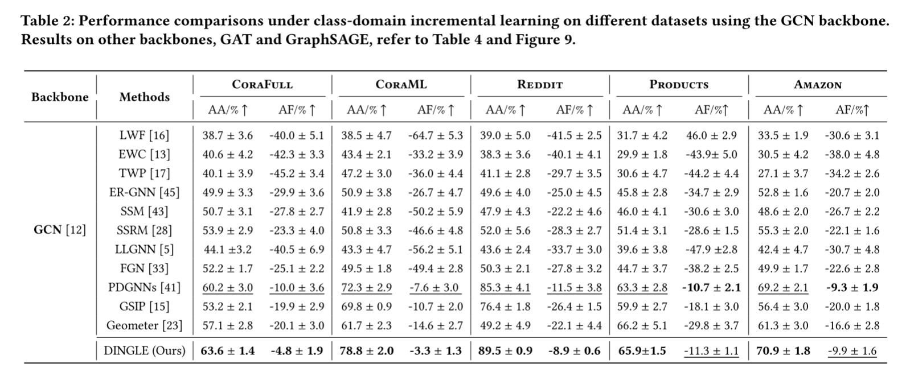
ATAI
AdvancedTechniqueof
Artificial Intelligence
ATAI
ChongqingUniversity _{AdvancedTechniqueof}
of Technology Artificial Intelligence
ChongqingUniversity of Technology
Experiments

Slide 7
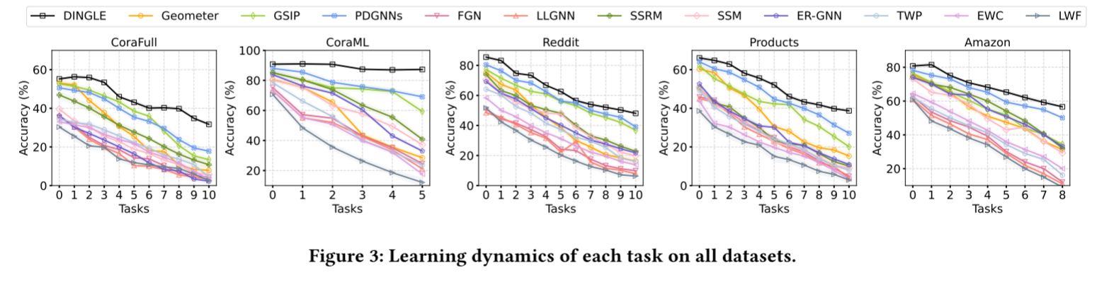
ATAI
AdvancedTechniqueof
Artificial Intelligence
ATAI
ChongqingUniversity _{AdvancedTechniqueof}
of Technology Artificial Intelligence
ChongqingUniversity of Technology
Experiments

Slide 8
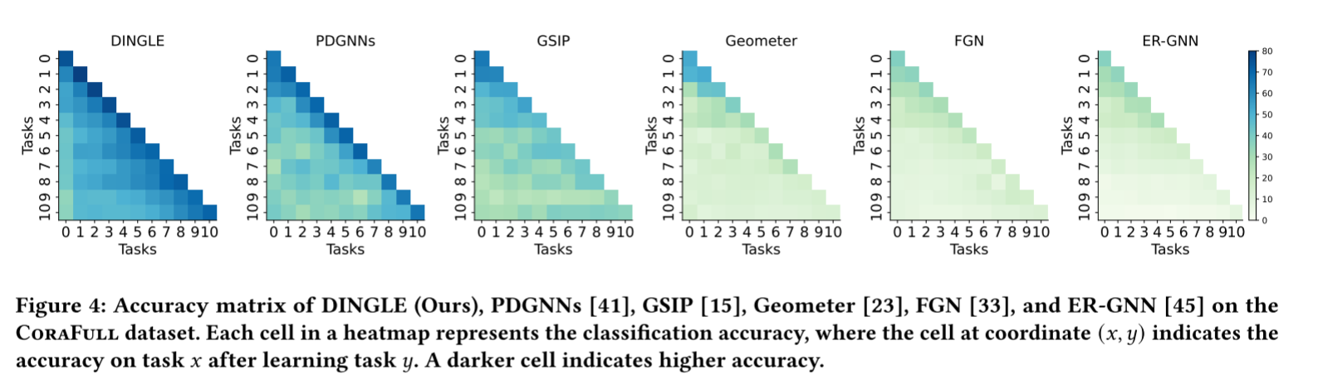
ATAI
AdvancedTechniqueof
Artificial Intelligence
ATAI
ChongqingUniversity _{AdvancedTechniqueof}
of Technology Artificial Intelligence
ChongqingUniversity of Technology
Experiments

Slide 9
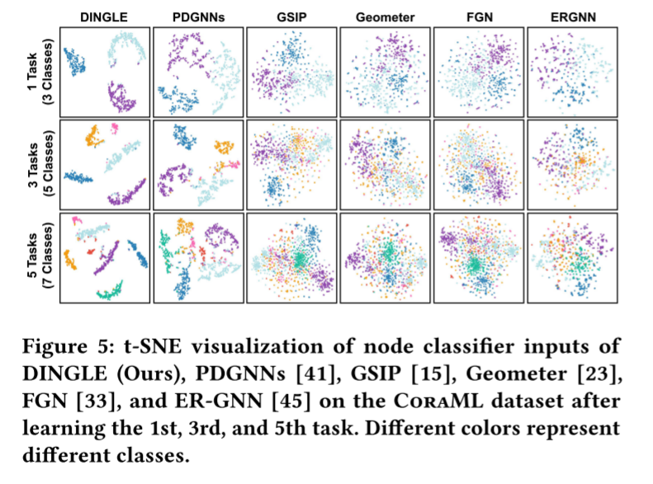
ATAI
AdvancedTechniqueof
Artificial Intelligence
ATAI
ChongqingUniversity _{AdvancedTechniqueof}
of Technology Artificial Intelligence
ChongqingUniversity of Technology
Experiments

Slide 10
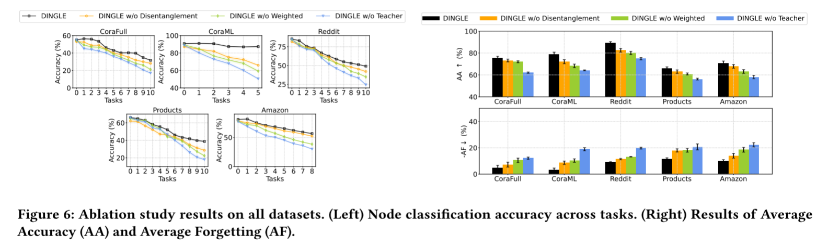
ATAI
AdvancedTechniqueof
Artificial Intelligence
ATAI
ChongqingUniversity _{AdvancedTechniqueof}
of Technology Artificial Intelligence
ChongqingUniversity of Technology
Experiments

Slide 11
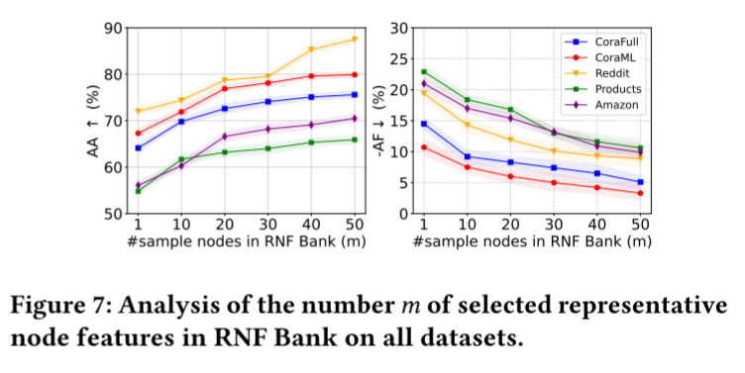
ATAI
AdvancedTechniqueof
Artificial Intelligence
ATAI
ChongqingUniversity _{AdvancedTechniqueof}
of Technology Artificial Intelligence
ChongqingUniversity of Technology
Experiments

Slide 12


ChongqingUniversity of Technology
ATAI
AdvancedTechniqueof
Artificial Intelligence
ATAI
ChongqingUniversity _{AdvancedTechniqueof}
of Technology Artificial Intelligence
Thanks!

